Slide 1
Campaign Performance Daily Drop
https://dailydroppk.com/
Abdullah
DHC-1903

Slide 2
Table of contents
01
02
03
04
05
06
About us
Campaign Planning
Campaign Goals
Content Sample
KPIs
Real-time tracking

Slide 3
Table of contents
07
08
09
Performance Analysis
Lessons Learned
Future Work

Slide 4


Meet Daily Drop
Daily Drop started with a simple goal — to bring quality, affordable products to people across Pakistan. From home essentials to tech gadgets, we Carefully choose items that make life easier and deliver them fast, at honest prices. Our customers trust us for great deals, reliable service, and products they’ll love.

Slide 5
01
About us

Slide 6
Our goals
Short term
Long term
Our main goals now are to sell more by improving our marketing and reaching more customers, work more efficiently to save money, and plan when to launch new products.
The overall goal of the company is to expand into new markets or geographies, develop and implement a strategy to reduce environmental impact and increase sustainability and increase market share

Slide 7
What sets us apart?
Always on time
Out-of-the-box
Customer service
We never miss a deadline. You can rely on us and rest assured that your product will be ready on time
Our out-of-the-box ideas are creative solutions that challenge the status quo and provide unique value
We focus on providing a high level of customer service so that the experience is positive

Slide 8
02
Campaign Planning

Slide 9
Campaign Planning
Target Audience: Age: 18–35 years, slightly more female-focused due to household & lifestyle products.
Location: Pakistan (major cities – Lahore, Karachi, Islamabad).
Interests: Online shopping, budget-friendly lifestyle, home improvement, tech gadgets, personal accessories, parenting.
Demographics: Students, young professionals, newlyweds, parents; smartphone users active on social media.

Slide 10
03
Campaign Goals

Slide 11
Campaign Goals
Page Awareness: Increase page awareness by 20% in 3 weeks through Instagram and Facebook Ads.
Reach: Reach 100K views on ads within 30 days.
Clicks: Generate 300 product link clicks in the first month.
Consistency: Increase reach consistently within the campaign period.

Slide 12
04
Content Samples

Slide 13
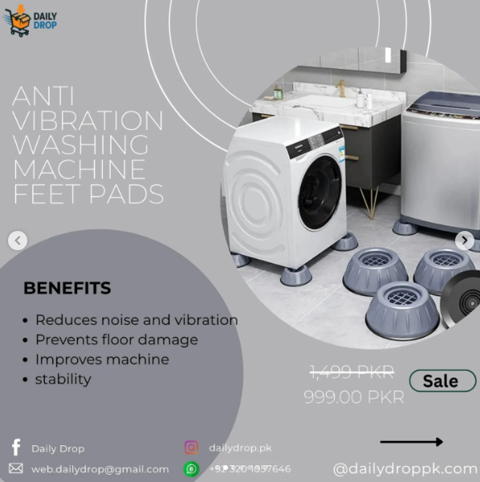
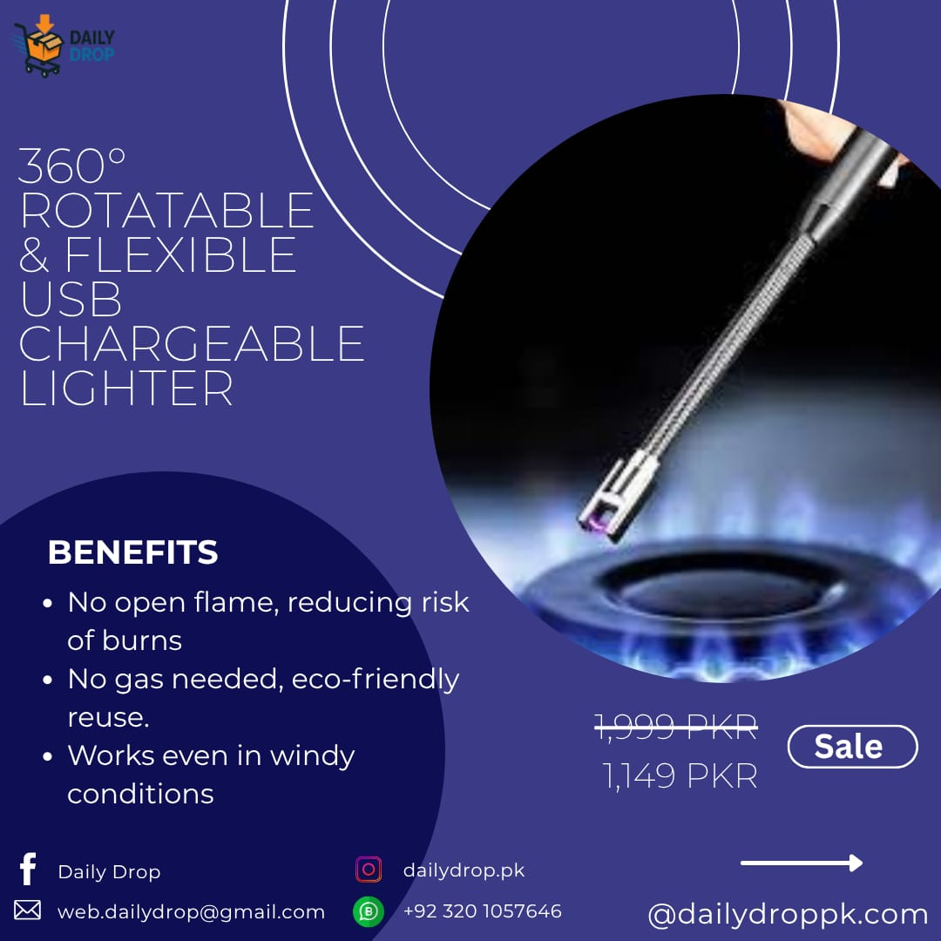
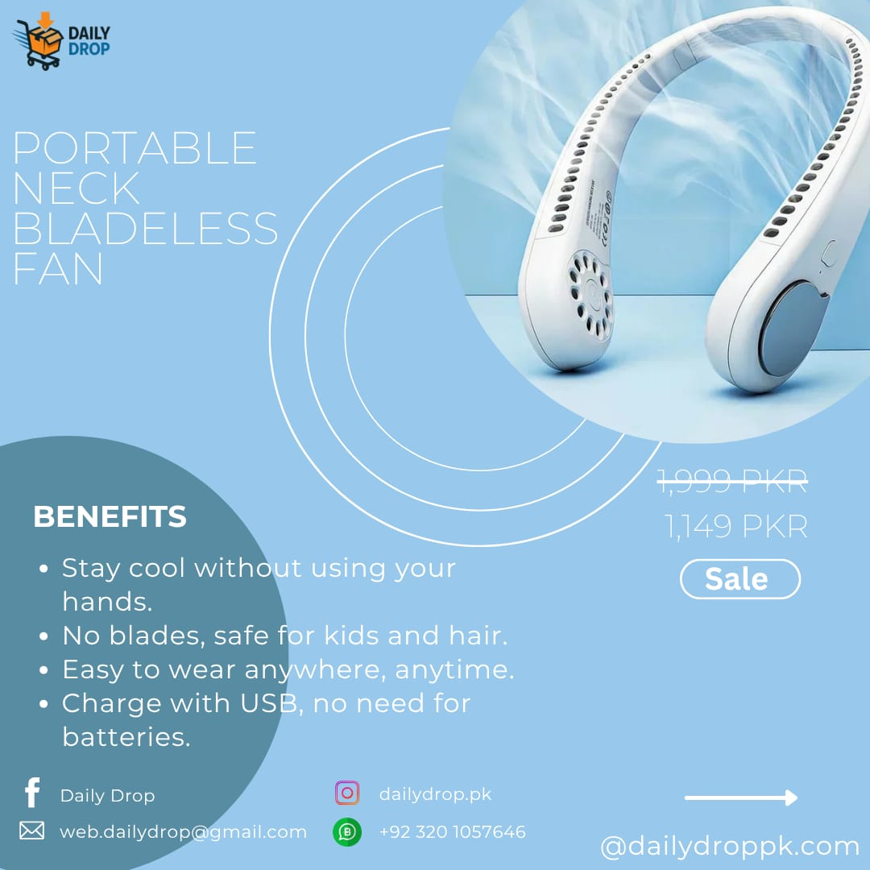

Slide 14
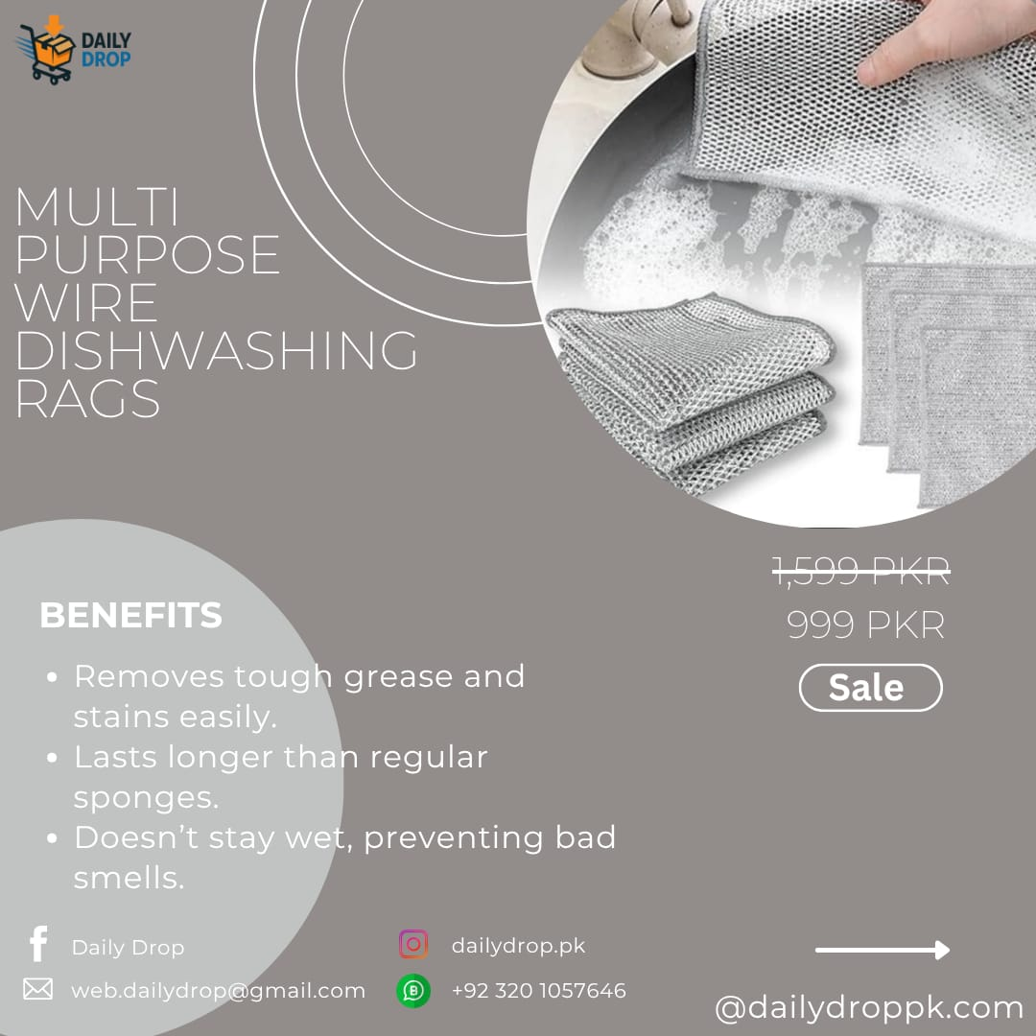
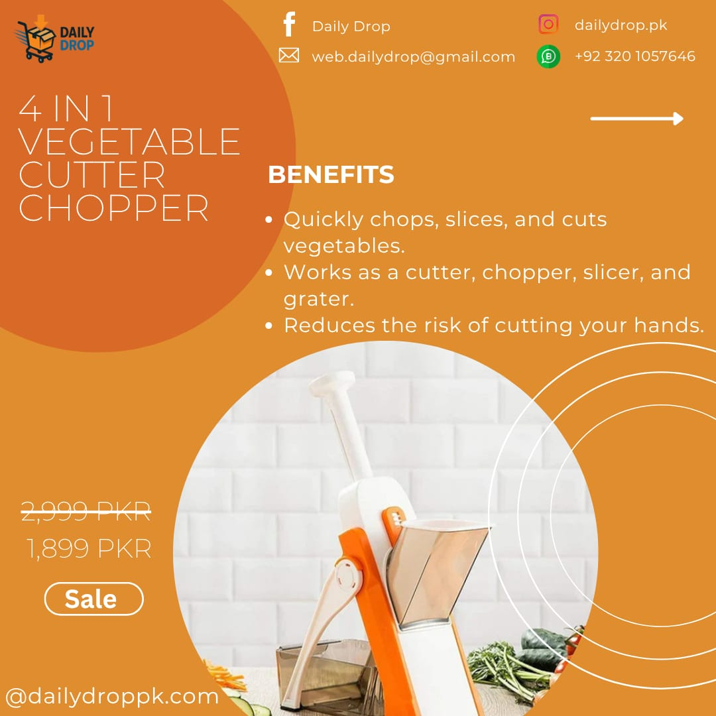

Slide 15
05
Key Performance Indicator

Slide 16
98,655 Reach | 116,726 Impressions
-- Recommendation Guidance 1.18 Frequency | 2.76 Purchase ROAS(return on ad spend) 1,252 Unique Clicks (all)
PKR 19.95 CPC (Cost Per Link Click) | PKR 184.40 CPM (Cost per 1000 Impressions)
0.92% CTR (Link Click Through Rate) | 1,079 Link Clicks
1.24% CTR (all) | 74 Website Checkout Initiated

Slide 17
06
Real-time tracking

Slide 18
Date | Ad Name | Reach | Impression | ROAS | Clicks | Unique Clicks | CTR | Sessions | Conversion Rate | Spend | CPC | CPM | Orders | Total Sales | ROI (%)
23-Jul | WMFP | 11,155 | 11,830 | 0.92 | 92 | 113 | 0.78% | 69 | 1.45% | 1304 | 13.01 | 101.16 | 1 | 1,099 | -15.72
24-Jul | WMFP | 5,928 | 6.057 | 1.77 | 63 | 76 | 1.04% | 62 | 3.23% | 1551 | 19.73 | 205.18 | 2 | 3,299 | 112.7
25-Jul | WMFP | 4,902 | 5,149 | 2.65 | 40 | 53 | 0.78% | 37 | 5.41% | 926 | 30.13 | 234.09 | 2 | 3197 | 245.25
26-Jul | WMFP | 5,660 | 5,819 | 6.78 | 59 | 70 | 1.01% | 53 | 13.21% | 2110 | 19.22 | 194.87 | 7 | 7,693 | 264.6
27-Jul | WMFP | 6,895 | 7,229 | 3.42 | 52 | 63 | 0.72% | 43 | 9.30% | 1,177 | 24.69 | 177.6 | 4 | 4,396 | 273.49
28-Jul | WMFP | 6,869 | 7,008 | 1.83 | 42 | 57 | 0.60% | 41 | 7.32% | 1,297 | 28.59 | 171.34 | 3 | 3,297 | 154.28
29-Jul | WMFP | 7,023 | 7,218 | 5.28 | 58 | 74 | 0.80% | 45 | 13.33% | 1,459 | 21.53 | 172.98 | 6 | 6,594 | 351.9
30-Jul | WMFP | 7,000 | 7,156 | 0 | 55 | 84 | 0.77% | 41 | 0% | 1,169 | 21.47 | 164.98 | 0 | 0 | -100
31-Jul | WMFP | 6,599 | 6,776 | 2.03 | 57 | 76 | 0.84% | 35 | 5.71% | 1,074 | 19.03 | 160.06 | 2 | 2,198 | 104.72
1-Aug | WMFP | 6,162 | 6,412 | 1.7 | 72 | 83 | 1.12% | 51 | 1.96% | 1,210 | 17.13 | 192.4 | 1 | 2,098 | 73.39
2-Aug | WMFP | 6,696 | 6,814 | 0.94 | 74 | 83 | 1.09% | 48 | 2.08% | 1,168 | 15.78 | 171.42 | 1 | 1,099 | -5.91
3-Aug | WMFP | 5,735 | 5,988 | 3.62 | 84 | 95 | 1.40% | 73 | 6.85% | 1,212 | 14.47 | 202.95 | 5 | 5,494 | 353.26
4-Aug | WMFP | 5,977 | 6,246 | 1.77 | 59 | 73 | 0.94% | 73 | 2.74% | 1,236 | 21.01 | 198.42 | 2 | 2,198 | 77.8
5-Aug | WMFP | 5,159 | 5,361 | 4.76 | 59 | 67 | 1.10% | 56 | 8.93% | 1,152 | 19.58 | 215.51 | 5 | 5,495 | 377.78
6-Aug | WMFP | 5,534 | 5,669 | 0.93 | 36 | 50 | 0.64% | 26 | 3.85% | 1,179 | 32.94 | 209.2 | 1 | 1,099 | -6.78
7-Aug | WMFP | 5,060 | 5,090 | 0.96 | 57 | 64 | 1.12% | 44 | 2.27% | 1,144 | 20.11 | 225.25 | 1 | 1,099 | -3.94
8-Aug | WMFP | 5,493 | 5,759 | 5.3 | 60 | 67 | 1.04% | 59 | 11.86% | 1,239 | 20.73 | 215.95 | 7 | 7,693 | 520.78

Slide 19
07
Performance Analysis

Slide 20
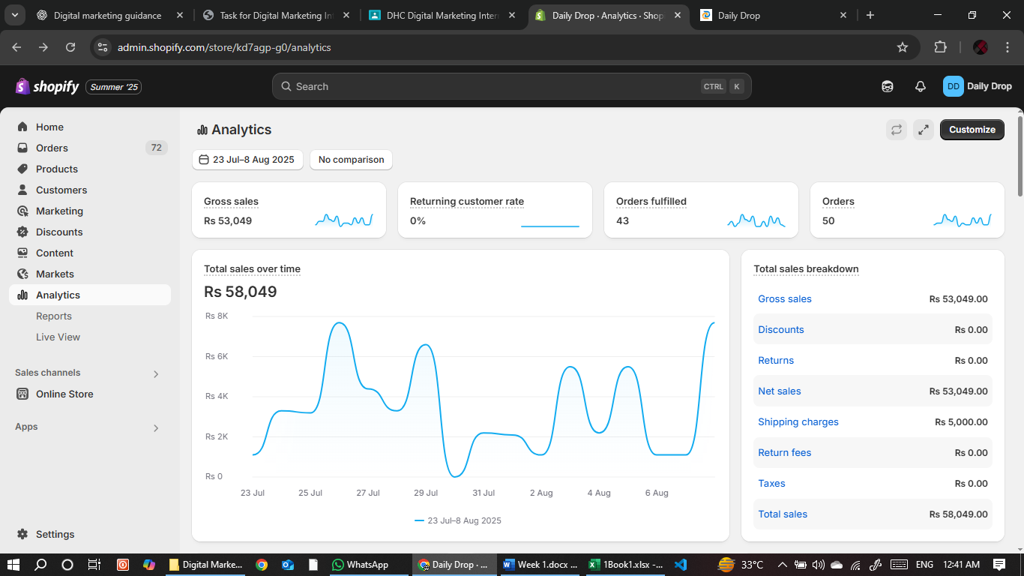

Slide 21
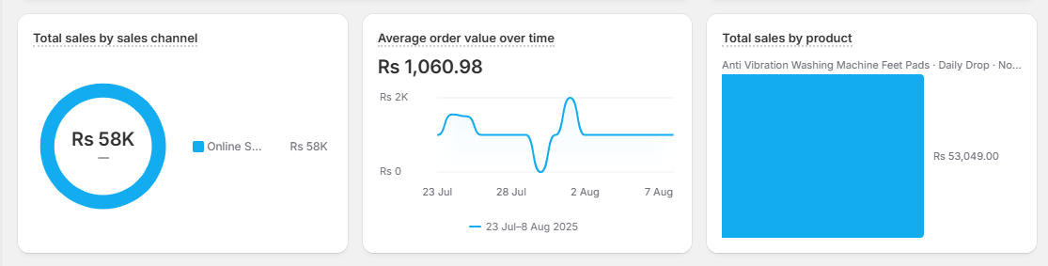
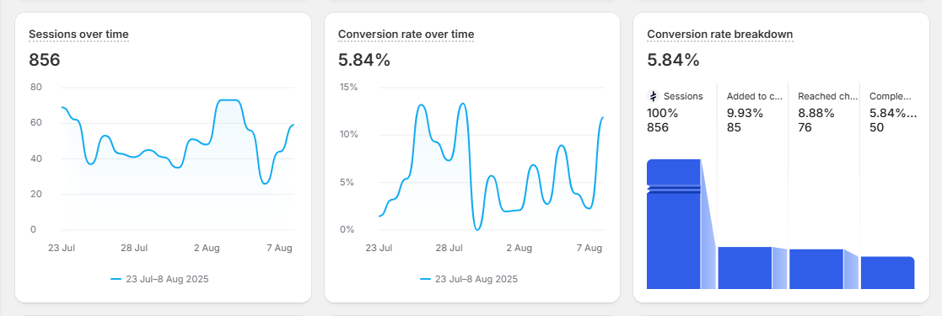

Slide 22
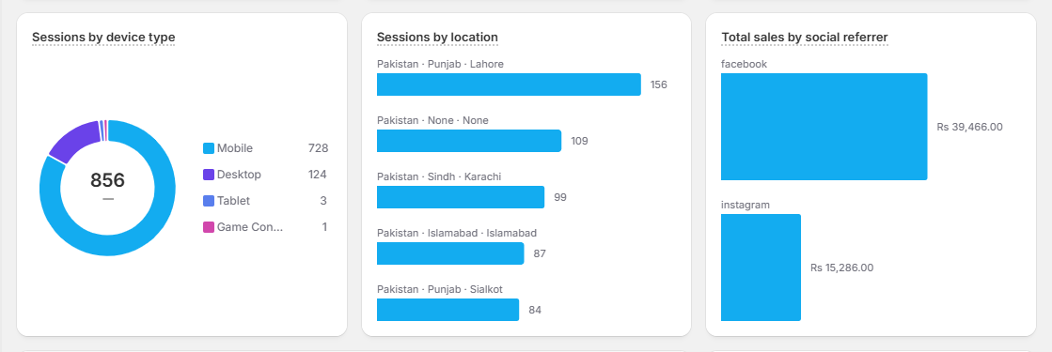

Slide 23
08
Lessons Learned

Slide 24
Lessons Learned
High ROI achieved when CTR and CR are both strong
Low CTR days often due to less engaging creatives
Low CR can be improved by better product page layout and urgency triggers
CPA under Rs. 300 consistently delivers high ROI

Slide 25
09
Future Work

Slide 26
Recommendations for Future Campaign
Increase budget for best time slots (4 PM – 7 PM)
Repurpose top creatives from 8-Aug and 5-Aug
Use limited-time offers to boost urgency
Target most engaged audiences and retarget visitors
Maintain CPA under Rs. 300 to ensure high profitability

Slide 27
Thanks
Do you have any questions?
Web.dailydrop@gmail.com
+92 320 1057646
Daily Drop

